Slide 1
Cuisine Diversity in NYC
Jen Eden
Jan 15, 2020

Slide 2
NYC
New York City is the most populous city in the United States, home to over 8.6 million people and over 800 languages. Undoubtedly, food diversity is an important part of a diverse metropolis. The idea of this project is to categorically segment the neighborhoods of New York City into major clusters and examine their cuisines. The intention with this analysis is to examine the neighborhood cluster's food habits and taste. Further examination might reveal if food has any relationship with the diversity of a neighborhood.

Slide 3
Data plan
This project will help to understand the diversity of a neighborhood by leveraging venue data from Foursquare’s ‘Places API’ and ‘k-means clustering’ machine learning algorithm. Exploratory Data Analysis will help to discover further about the culture and diversity of the neighborhood. This project can be utilized by a new food vendor who is willing to open his or her restaurant in a particular neighborhood. Likewise government authorities may examine and study New York City's culture diversity better.

Slide 4
Data
New York City Dataset Link:
https://geo.nyu.edu/catalog/nyu_2451_34572 Description: This New York City Neighborhood Names point file was created as a guide to New York City’s neighborhoods that appear on the web resource, “New York: A City of Neighborhoods.”
Foursquare API: Link:
https://developer.foursquare.com/docs Description: Foursquare API, a location data provider, will be used to make RESTful API calls to retrieve data about venues in different neighborhoods.

Slide 5
Explore the city
To segment the neighborhoods of NYC, a dataset with latitudes and longitudes of each neighborhood is required.
The python dictionary is transformed into a pandas dataframe and the data looped through in order to fill in the information.
After analysis, 5 boroughs and 306 neighborhoods were identified

Slide 6
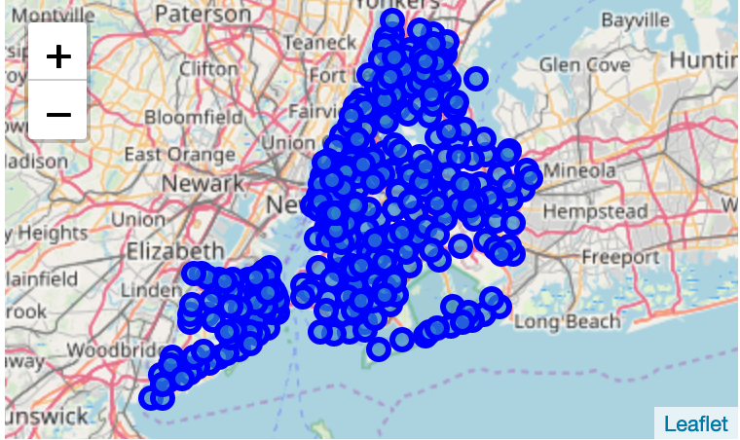
Folium library

Slide 7
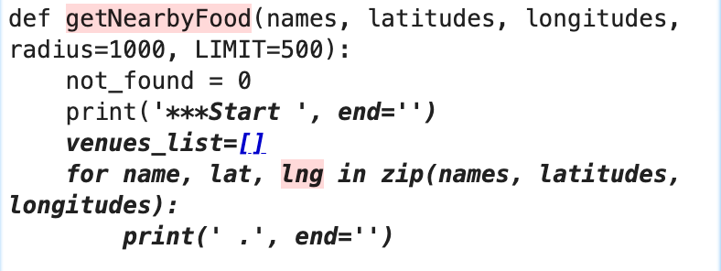
GetNearbyFood
To overcome redundancy ‘getNearbyFood’ was created. This function loops through all NYC neighborhoods and creates an API request URL with radius = 500 and limit of 100 nearby venues.
The neighborhood and nyc_venue dataframes were merged.

Slide 8
Machine learning
K-means is an unsupervised machine learning algorithm which creates clustersof data pints aggregated together because of similarities.
Elbow method
Calculates the sum of squared differenes of the closest cluster center for different values of k
Silhouette method
Measues how similar a point is to its own cluster compared to other clusters.
After running both analyses it was determined that 8 clusters were warranted for this analysis.

Slide 9
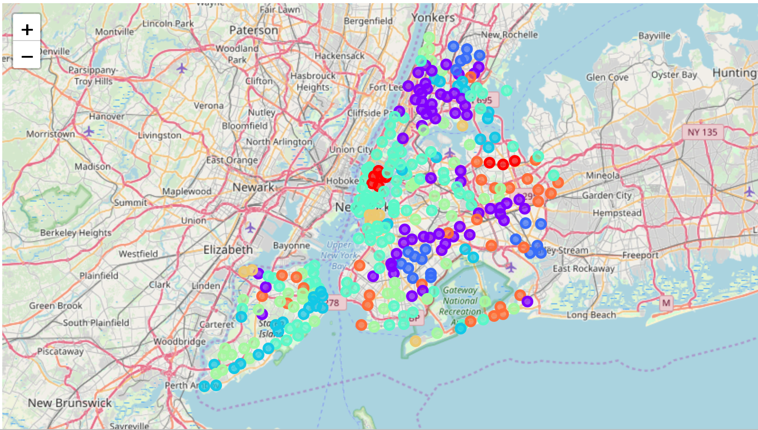
NYC clusters

Slide 10
Clusters
Cluster 0 = Korean
Cluster 1 = Fast Food
Cluster 2 = Caribbean
Cluster 3 = Italian
Cluster 4 = American
Cluster 5 = PIzza
Cluster 6 – American
Cluster 7 = Chinese

